Slide 1
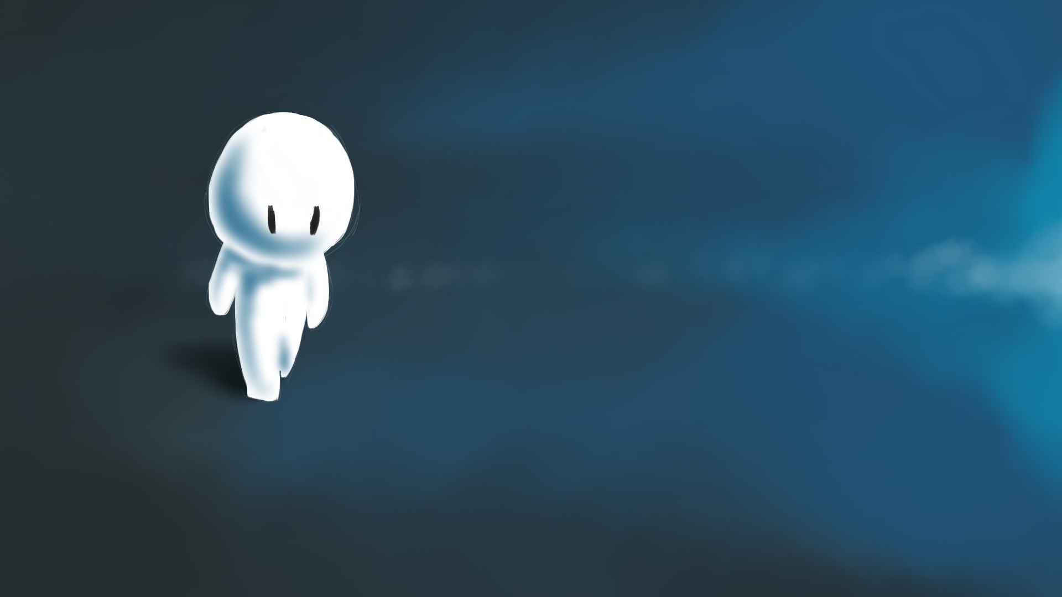


The atmosphere seems to know what I’m thinking. The overcast skies and damp air mirror my own downcast mood. The money is just not going to stretch, I cannot see any way to make ends meet this time. Hope seems a distant memory. What can I do?
Click to continue.
Start again

Slide 2
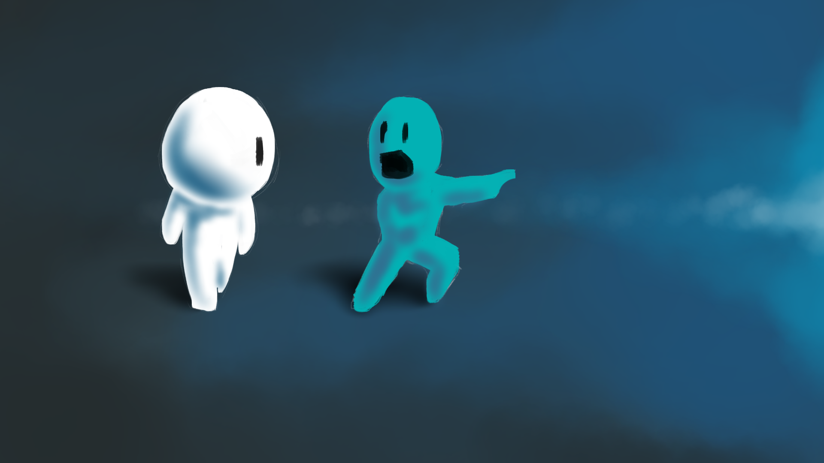

Click here to go see this guy
Click here to figure out your situation
What’s that? There’s a guy that’s been helping people! Helping the sick and the poor. He’s been teaching the best ways to live and loves to spend time with people that no one else wants to be around. But I don’t have time for that, I need to figure things out don’t I?
Start again

Slide 3
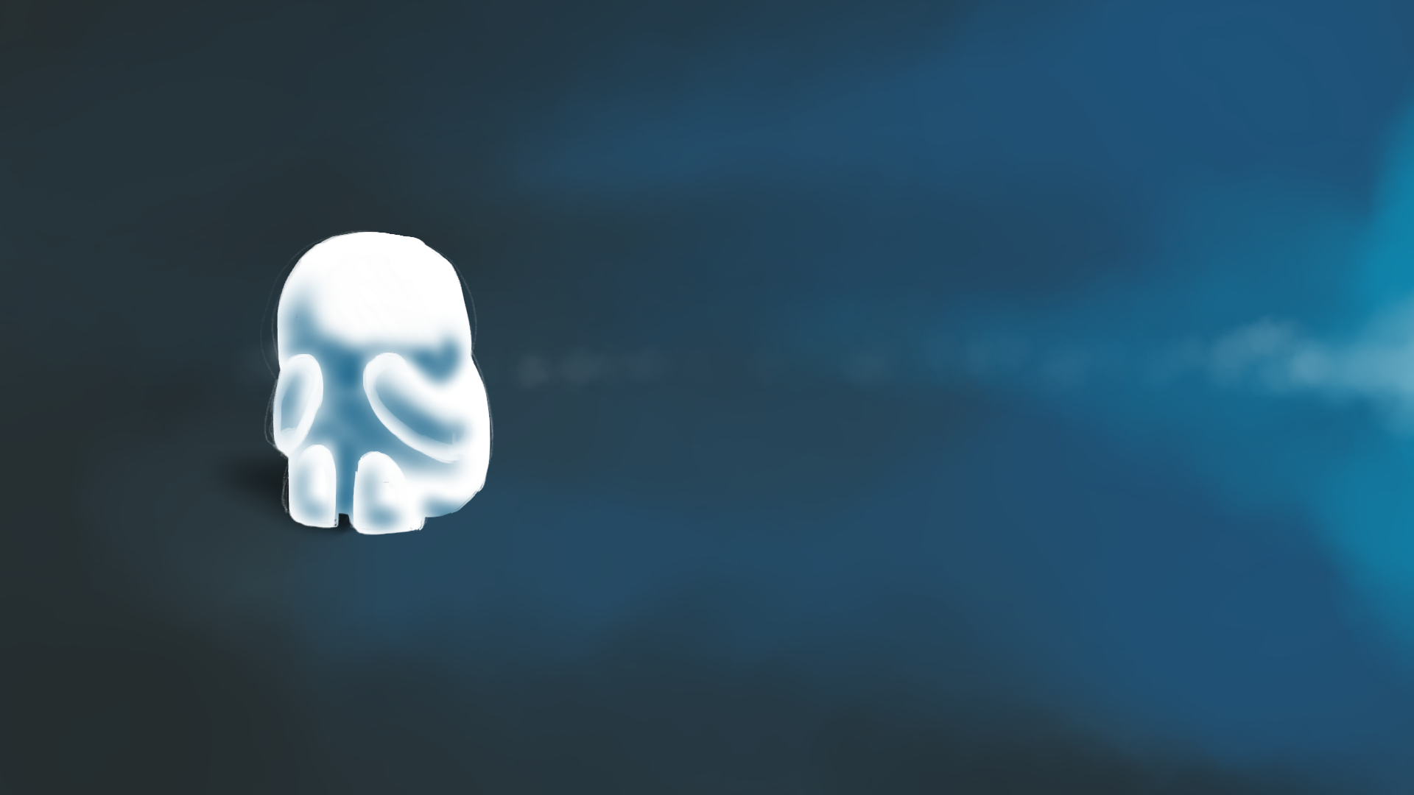
I’m being silly, just keep going. Pick myself up and look for work.
Stuff the system. It’s done nothing for me. I’m going to take what I’m owed.
I can’t figure out my money troubles. I’m trying! I’m trying! I’m trying! I can’t figure it out! I’ve always been good, I’ve done what I’ve supposed to so how have I got to this point! I’m just fed up of this. What do I do?
Start again

Slide 4
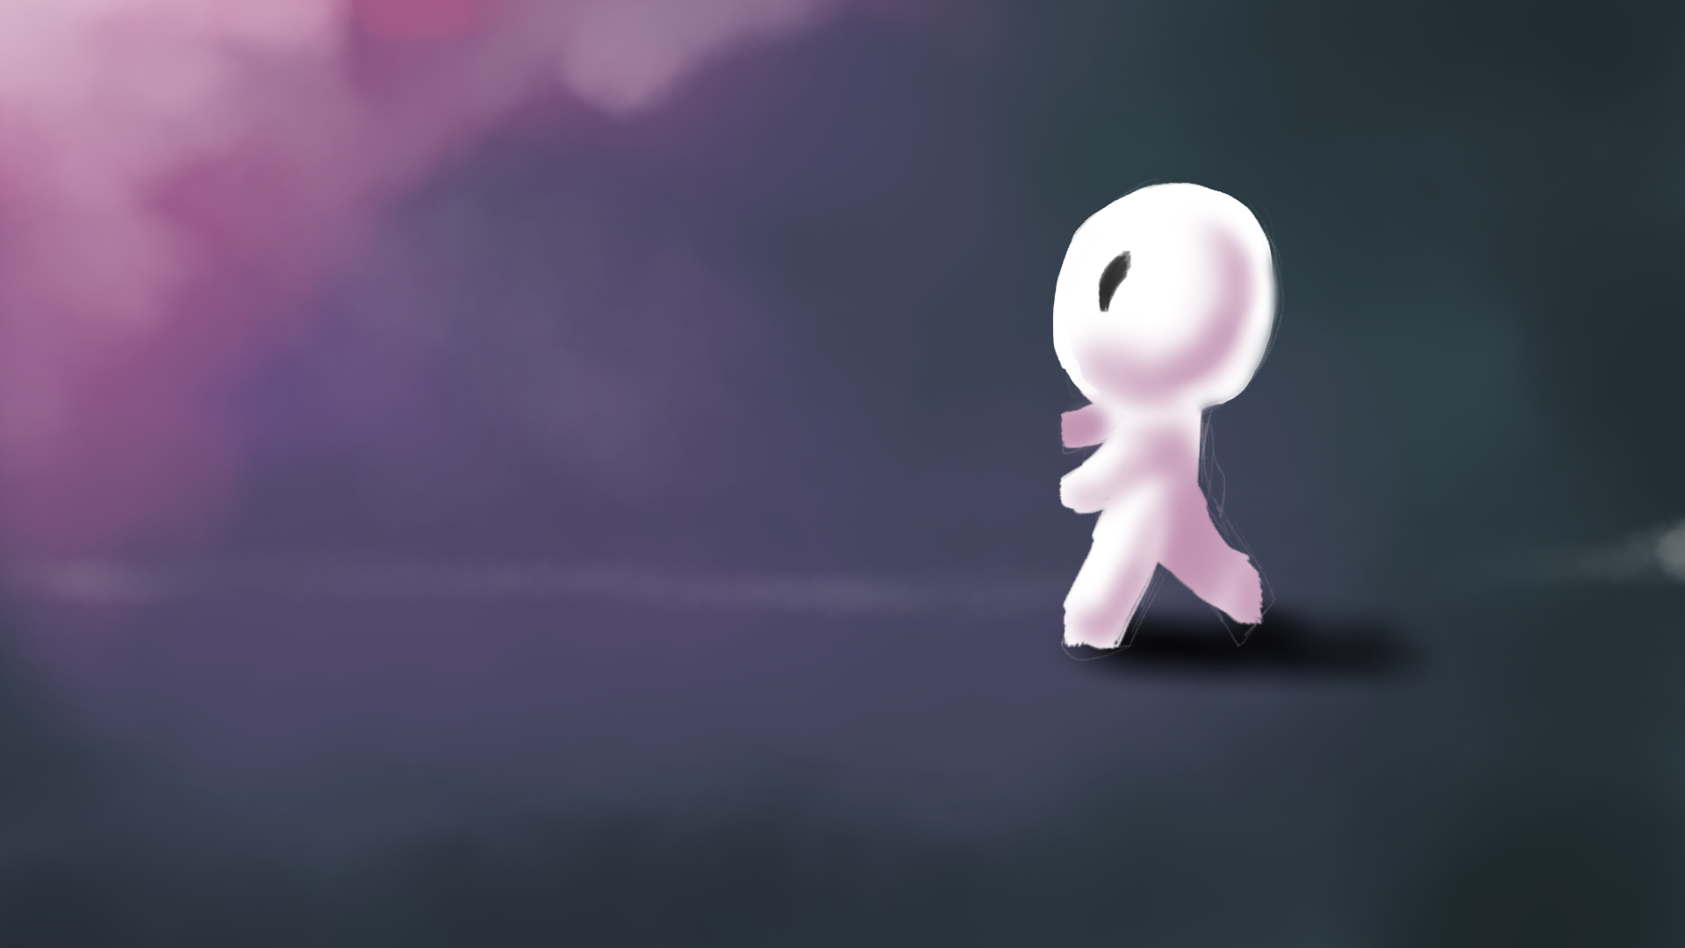
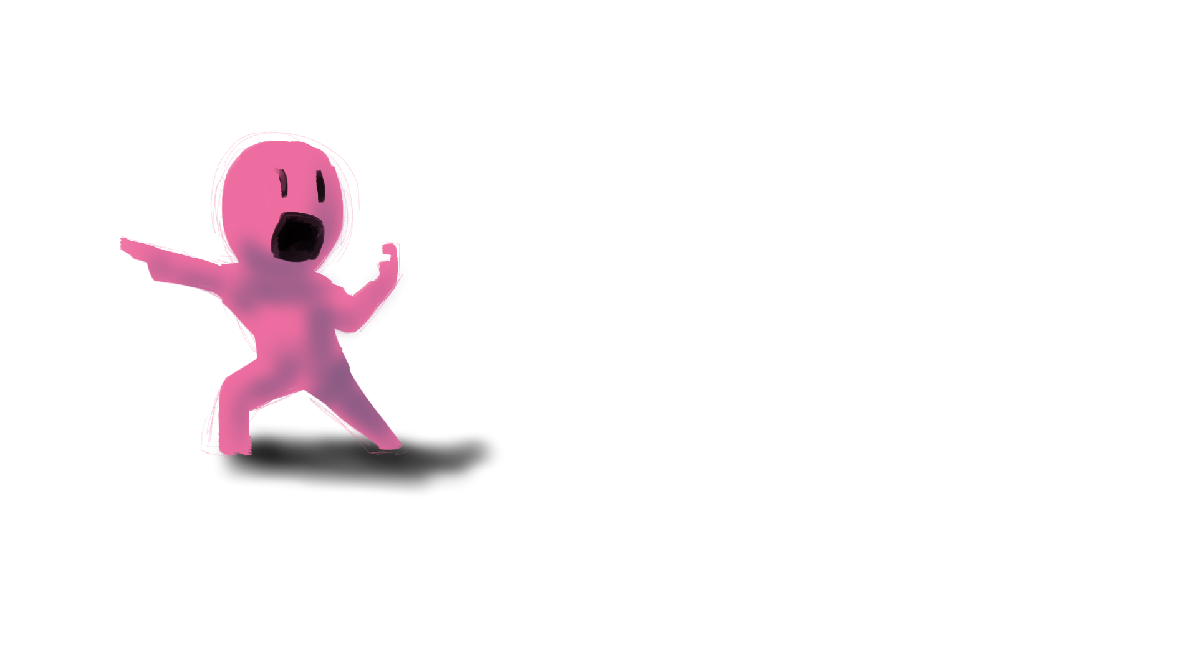
Go with these crazy guys and figure out what this Jesus guy is all about.
That’s it. I’ve got to take care of myself, no matter what.
How?! How can no one need a hard woker?! I’ve been everywhere, but no one can use me. I just don’t understand it.
What’s that? Another one raving about this guy. I guess this is it, I’ve got to choose…
Start again

Slide 5
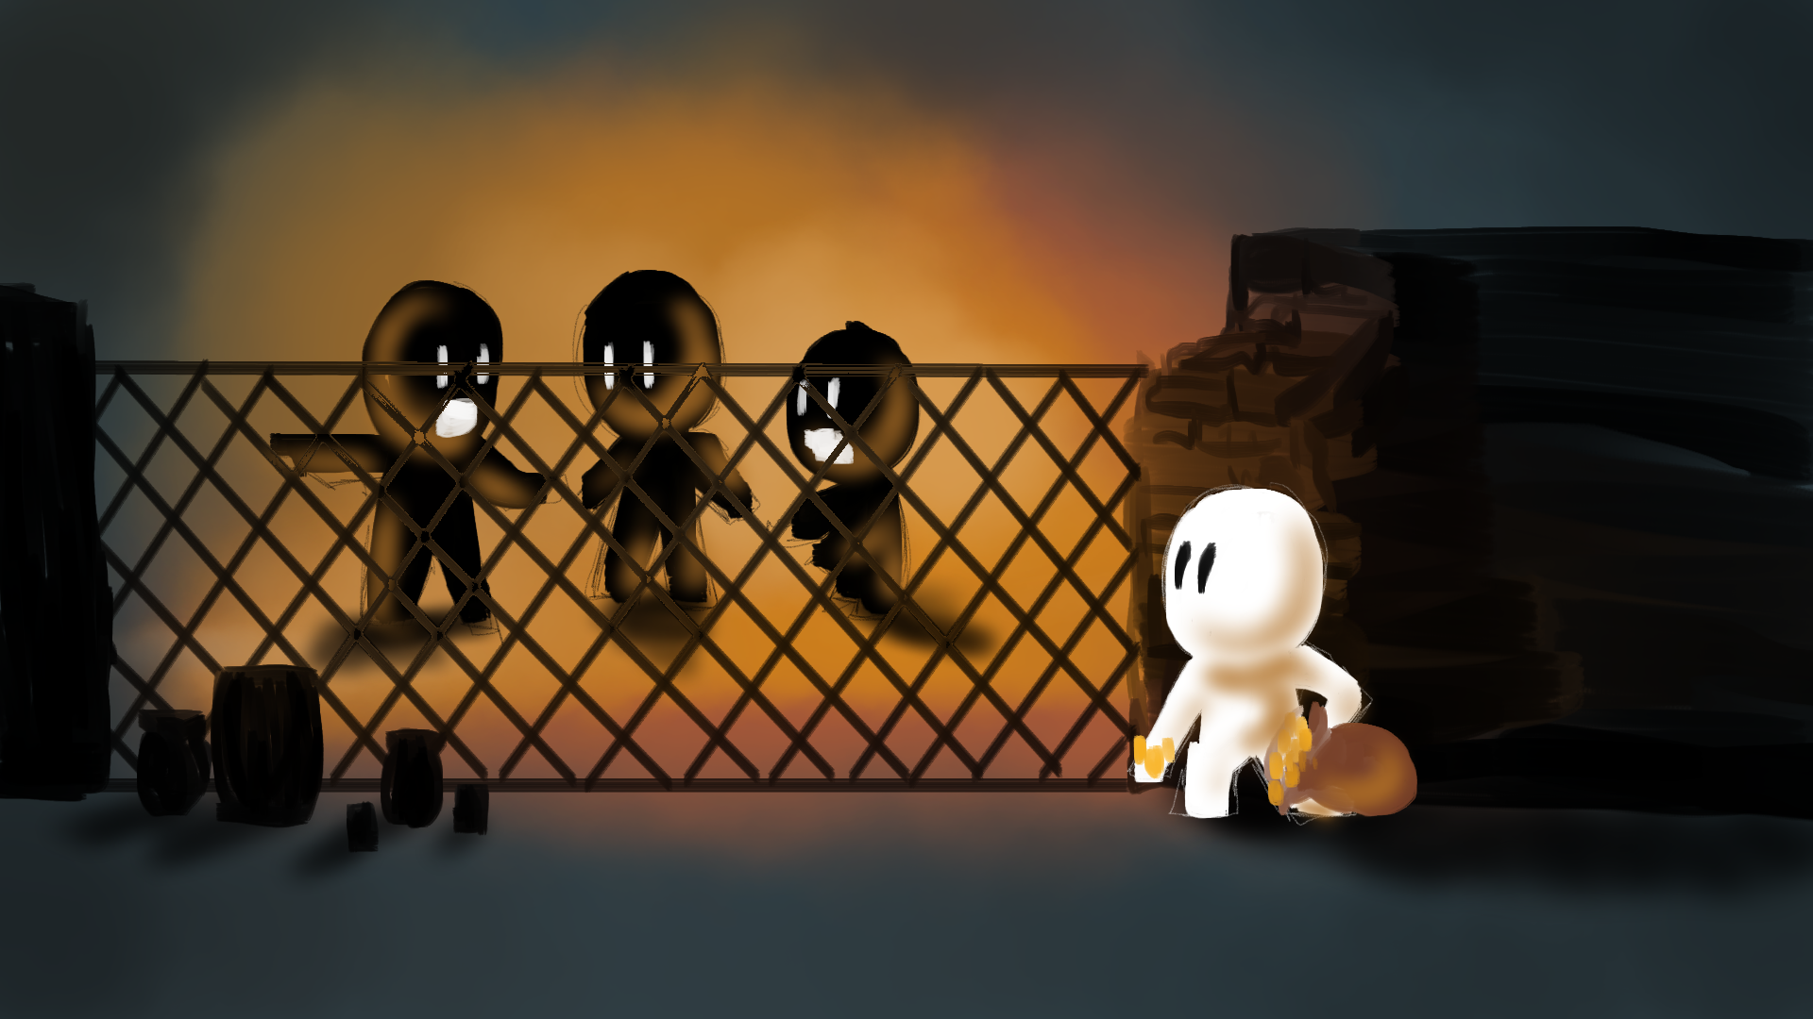
Sneak out through the back door.
Pretend to be a servant to escape.
I knew these guys had money, they were important. But while I was there I heard them talking about this guy that everyone’s been talking about. But these guys hate him. Say he’s been lying to everyone about being God! But I’ve got to get out with what I’ve got.
Start again

Slide 6
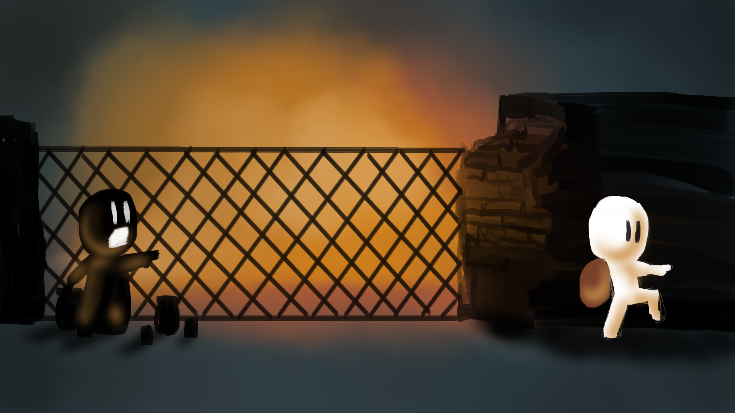
Uh-oh…I think he saw me. From here it was straight to prison and because these guys were so important, I was sentenced to death. So I guess that’s it, that’s the end of my pointless existence. Click to continue.
Start again

Slide 7
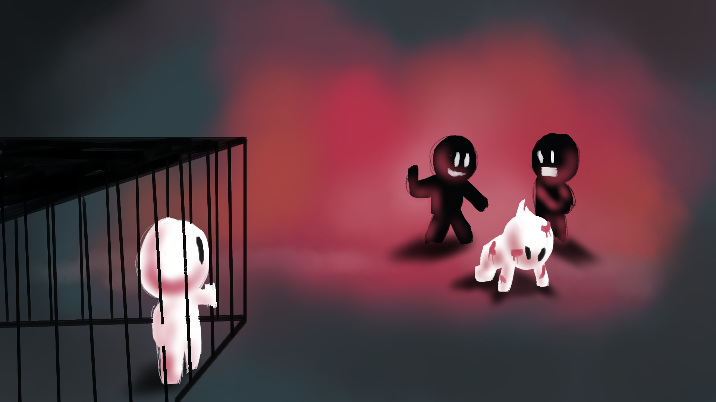
While I was waiting, I saw them bring this guy in. He was the guy everyone was talking about. Now I don’t know who was telling the truth but the beating they gave him…I hadn’t seen anything like it. This was no trial, this was torture for the sake of it.
I knew it was unfair. I couldn’t bear to see it, I just wanted to help.
But I had enough to think about. This guy wasn’t my problem.
Start again

Slide 8
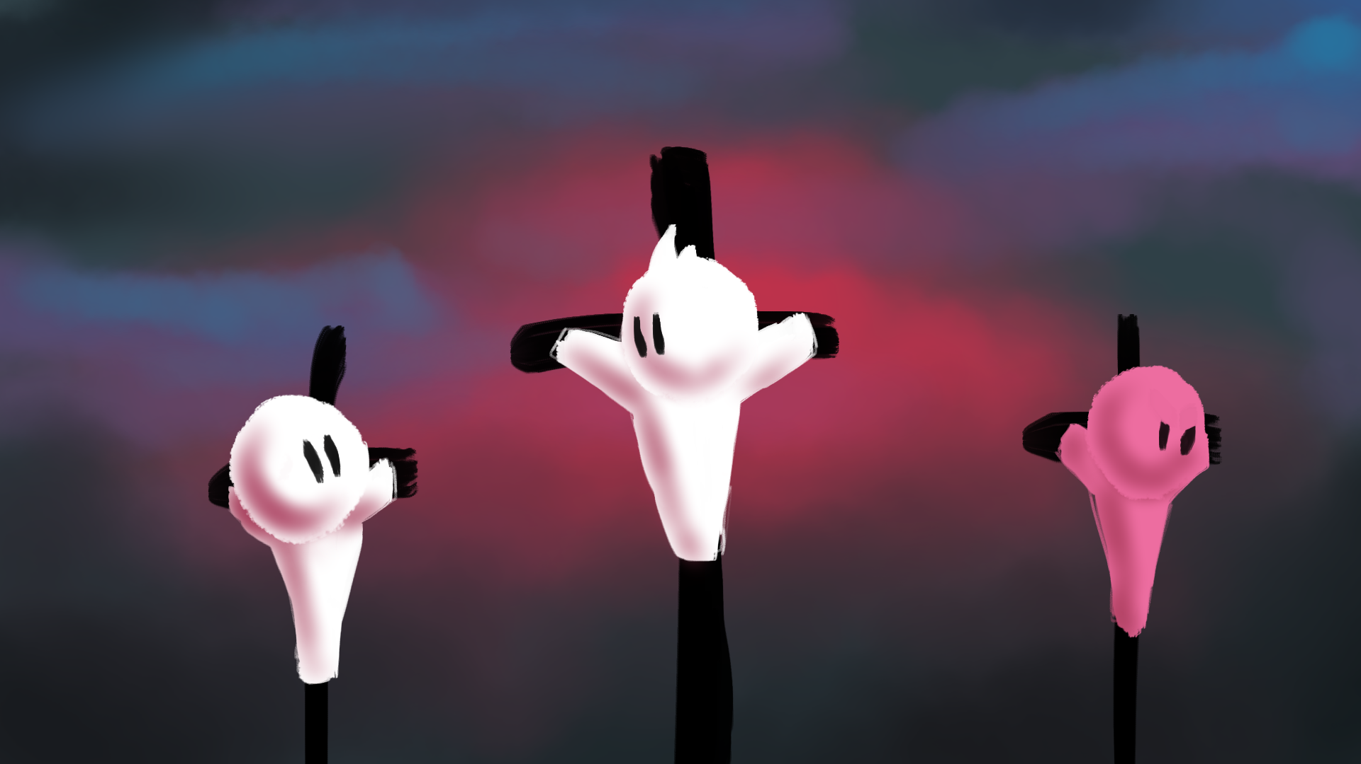
The day finally came, it was me, the guy who I learned was called Jesus and another thief like me. Nailed to bits of wood and left to rot while passers by came and mocked us. Some even made a day of it, like they enjoyed seeing us in pain. Click to continue.
Start again

Slide 9
It took a long time for us to die and every moment was agony. It was hard not to get bitter. The other thief joined in the mocking said “some god you are, why don’t you save yourself and save us?” Click to continue.
Start again

Slide 10
I couldn’t bear it, the more I thought about it the more I realised that this Jesus had done nothing wrong. He was only up here because those important people were afraid of him, so I piped up. Click to continue.
Start again

Slide 11
“Don’t you get it? Don’t you have any respect for God? This guy has done nothing wrong unlike us. We deserve this. He is blameless.” I looked at Jesus, “I get it now. You must be God. Remember me when this day is over and we are gone.” Click to continue.
Start again

Slide 12
There was an earthquake, it went pitch black and there was a load of commotion over by the temple. I could hear that Jesus had stopped breathing. God was dead and the earth was mourning. And that’s my last living memory.
Click here to continue.
Start again

Slide 13
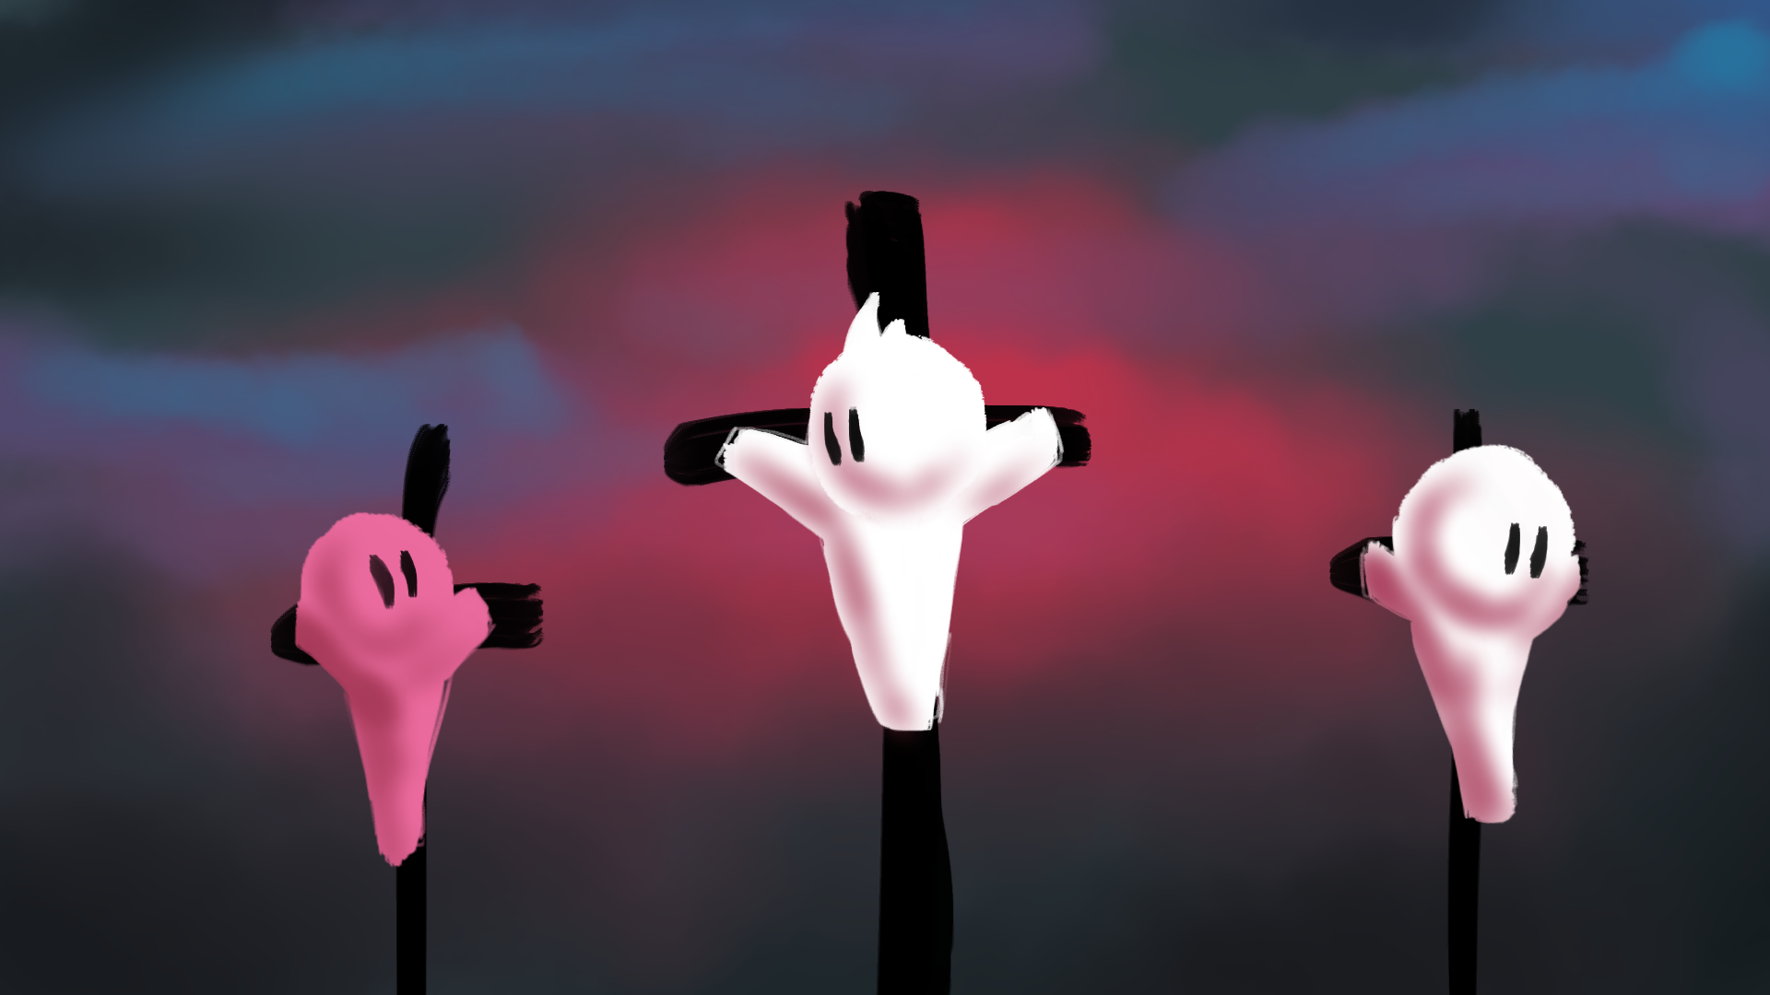
The day finally came, it was me, the guy who I learned was called Jesus and another thief like me. Nailed to bits of wood and left to rot while passers by came and mocked us. Some even made a day of it, like they enjoyed seeing us in pain. Click to continue.
Start again

Slide 14
It took a ages for us to die and it was agony. What had I done to deserve this? Sure I stole some stuff, but this? Then I remembered this Jesus guy was meant to be God so I pipe up “some god you are, why don’t you save yourself and save us?” Click to continue.
Start again

Slide 15
Then the other thief starts talking back at me “Don’t you get it? Don’t you have any respect for God? This guy has done nothing wrong unlike us. We deserve this. He is blameless.” Who does he think he is? Click to continue.
Start again

Slide 16
Jesus and the other guy talked a little more but I was too furious to listen. What made this thief think he was better than me? I was so full of anger and hate, hatred for the thief, hatred for the crowd. I even hated this Jesus. Click to continue.
Start again

Slide 17
Then it happened. There was an earthquake, it went pitch black and there was a load of commotion over by the temple. I could hear that Jesus had stopped breathing. And then I realised, he must’ve actually been God. I had made a huge mistake.
Click here to continue.
Start again

Slide 18
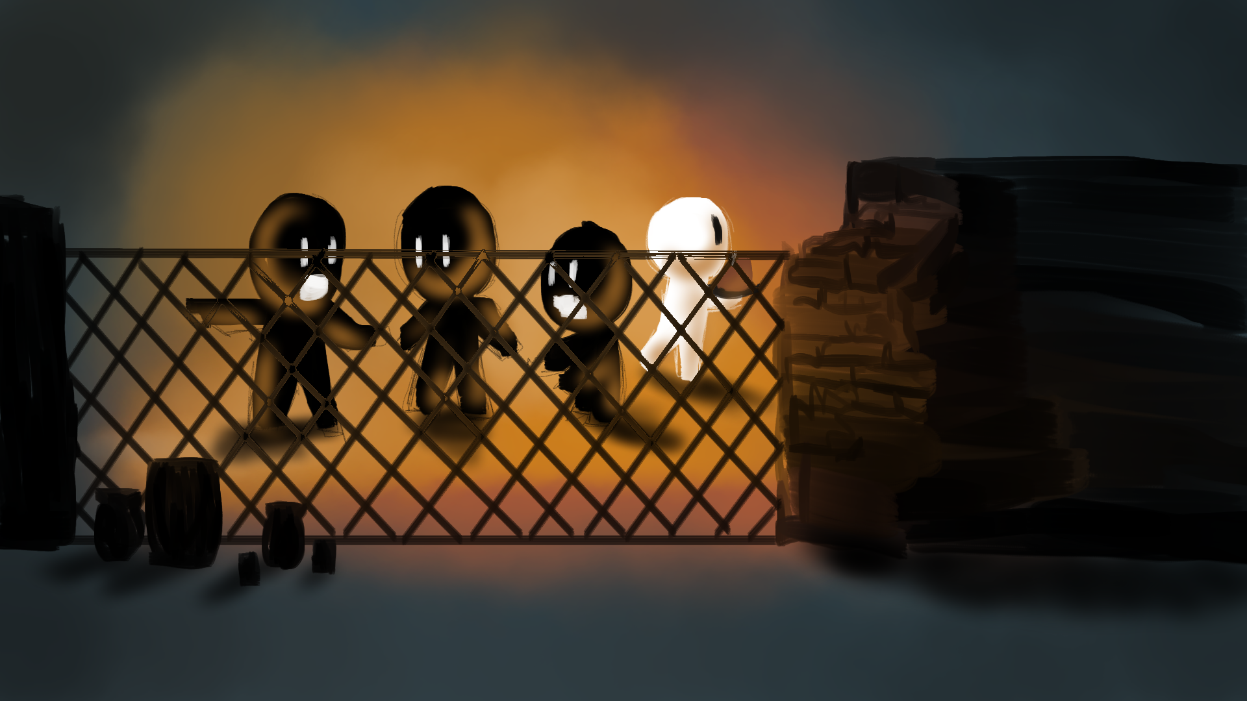
And that was that. Snuck out right under their noses and now I’m set up nicely for a little while. But I can’t believe what they were saying about that guy! I’ve got to tell people, I don’t want them following some false god. Click to continue.
Start again

Slide 19
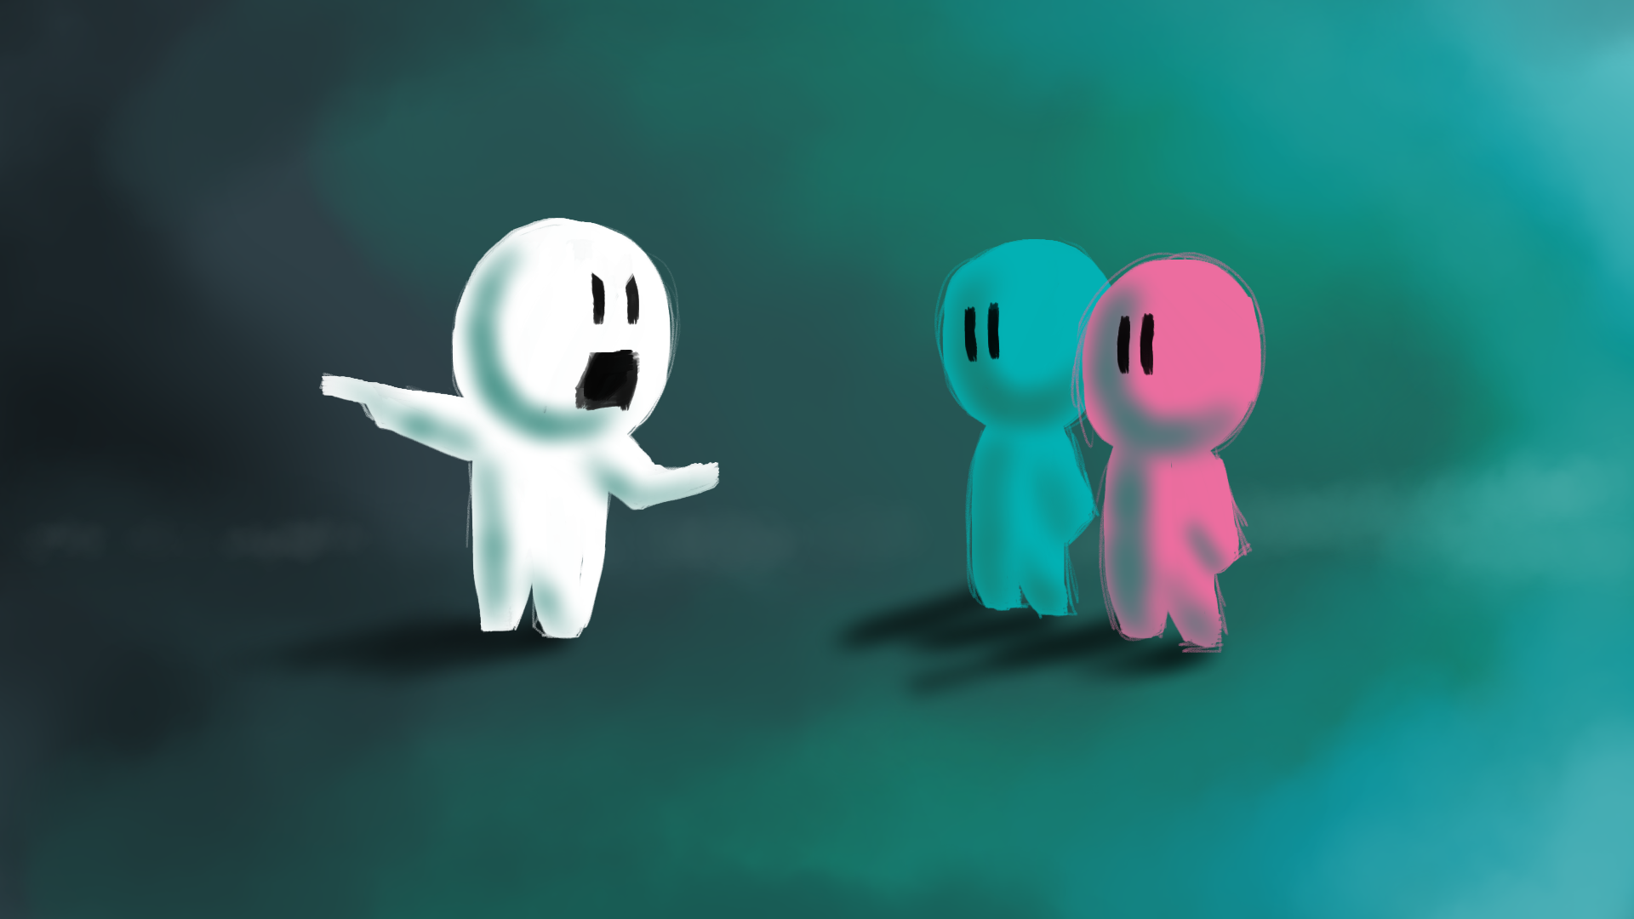
I told everyone I could find. I didn’t want anyone to be tricked by this guy. I was ok without him so I knew other people would be. Then I heard it finally caught up to him. This guy, Jesus had been arrested for claiming to be God. Click to continue.
Start again

Slide 20
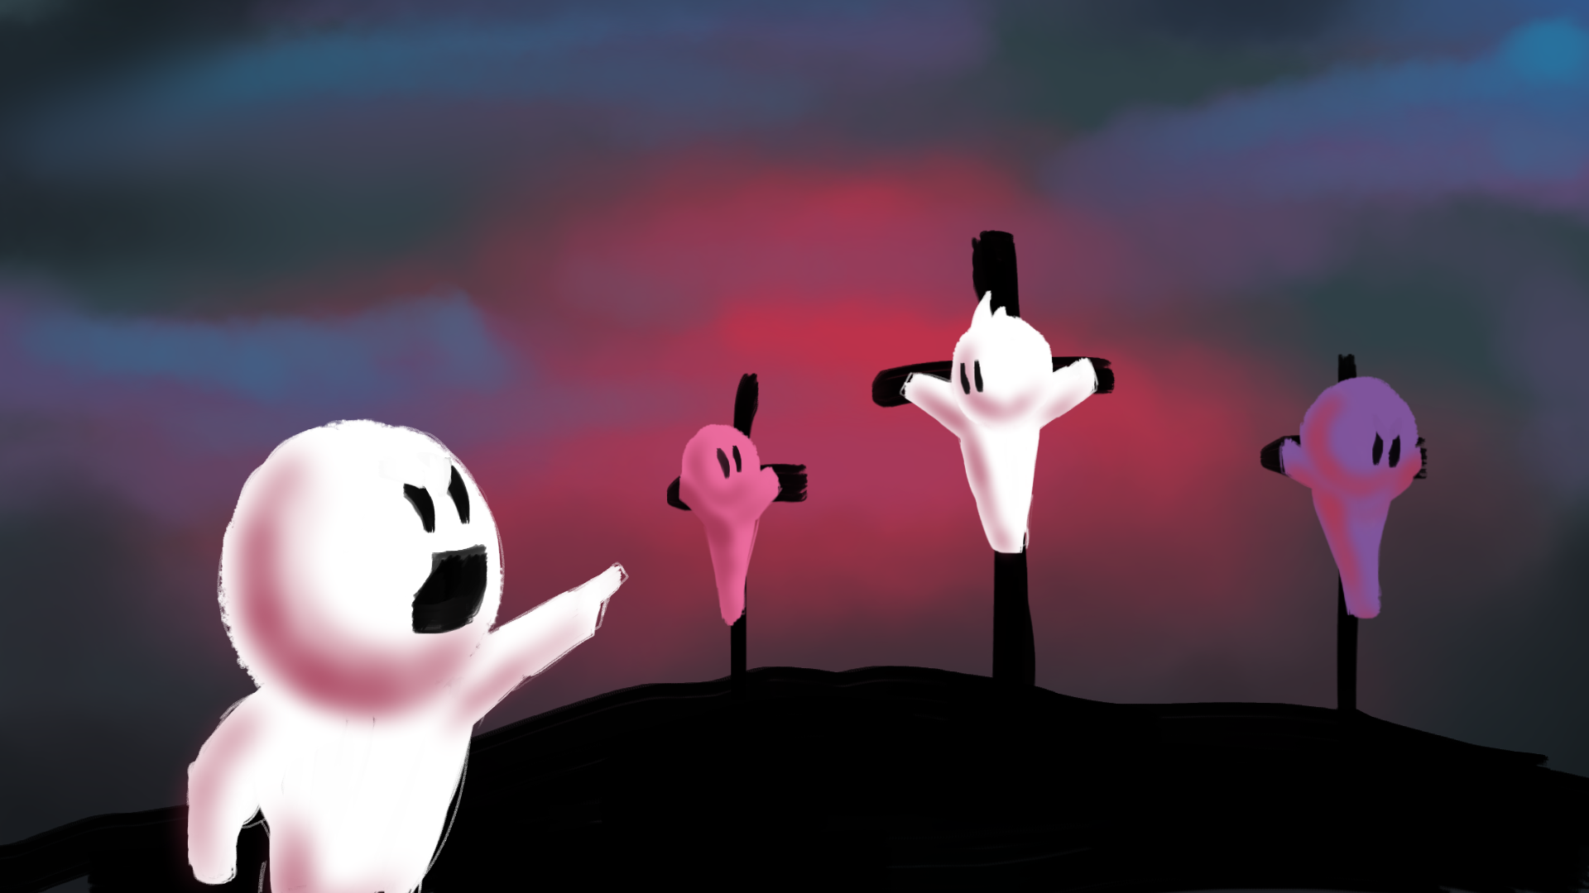
I went to his execution. I wanted to tell him just what I thought of him, the liar who had fooled hundreds finally getting his just desserts. I enjoyed seeing him like that until I realised it could’ve been me up there if I’d been caught. Click to continue.
Start again

Slide 21
Then it went dark and the ground began to shake. I didn’t know what was happening. Could it be that this guy actually was God and this is what it looks like when God dies? Or was it just coincidence?
I didn’t have time to think about it, I just needed to get out of there.
Maybe I was wrong. Maybe he really was God. I needed to find out more.
Start again

Slide 22
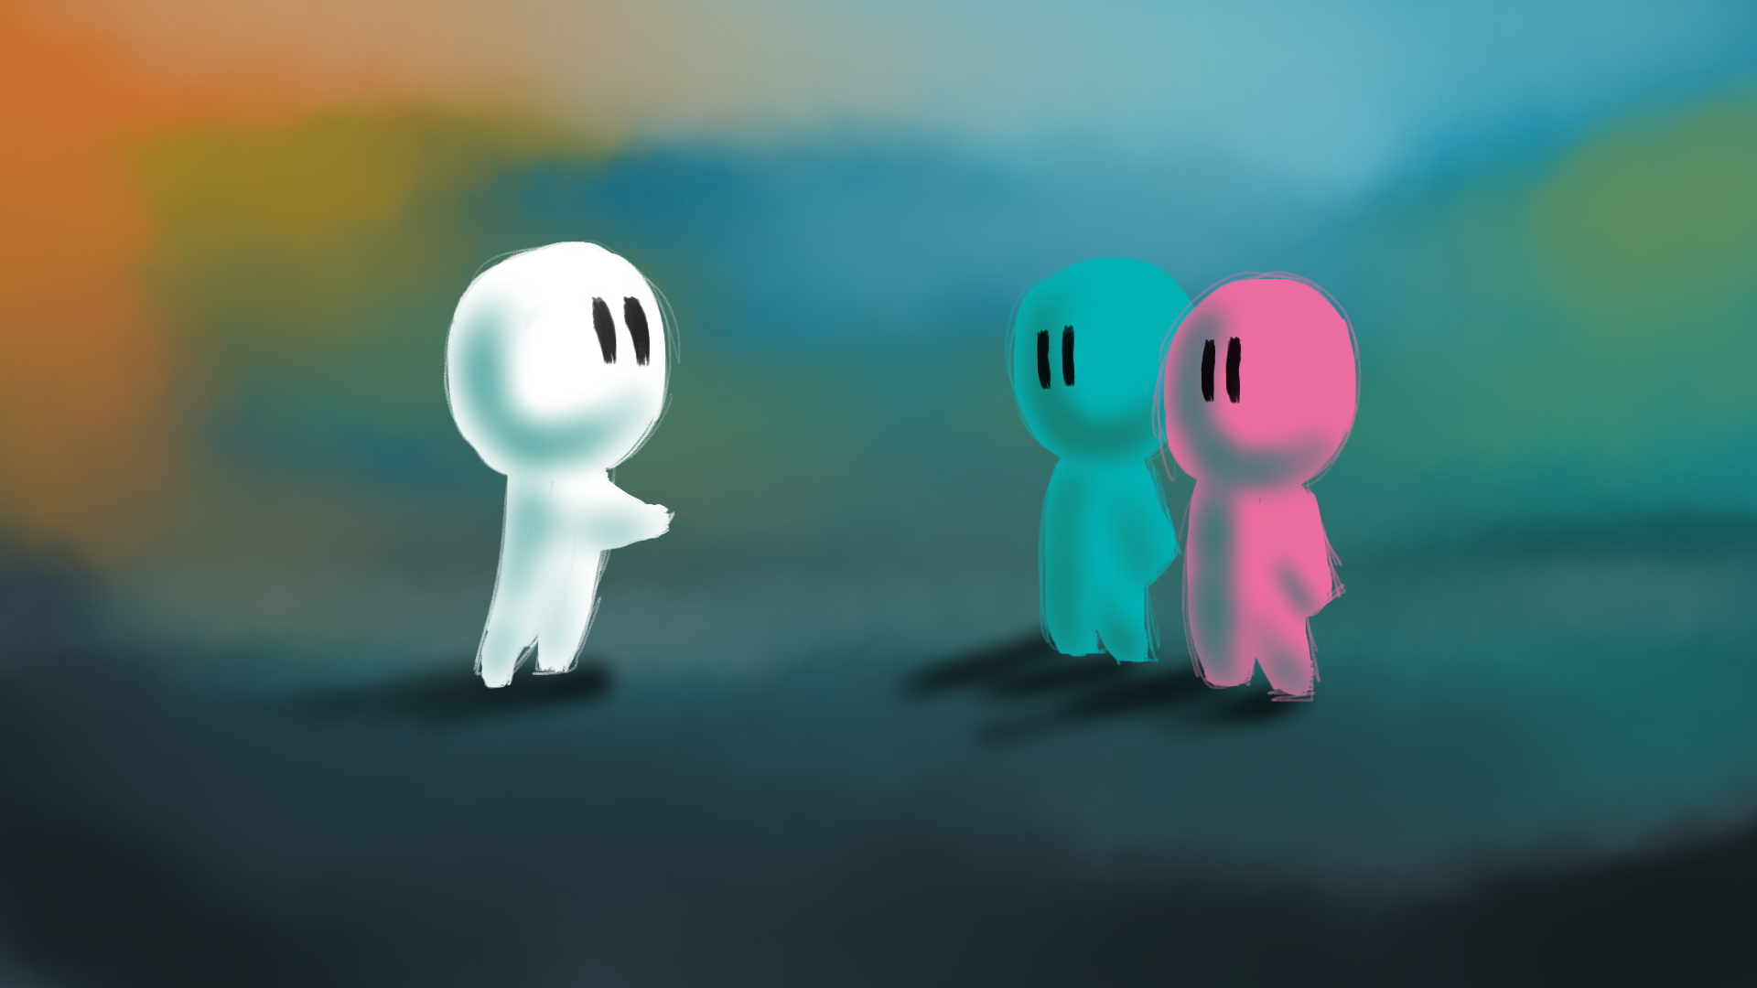
Click here to continue.
I ran to find those who first told me about him. Jesus was God, Jesus is God! This truth changed my life, time to continue what Jesus started. And that’s exactly what we did until the day we died.
Start again

Slide 23
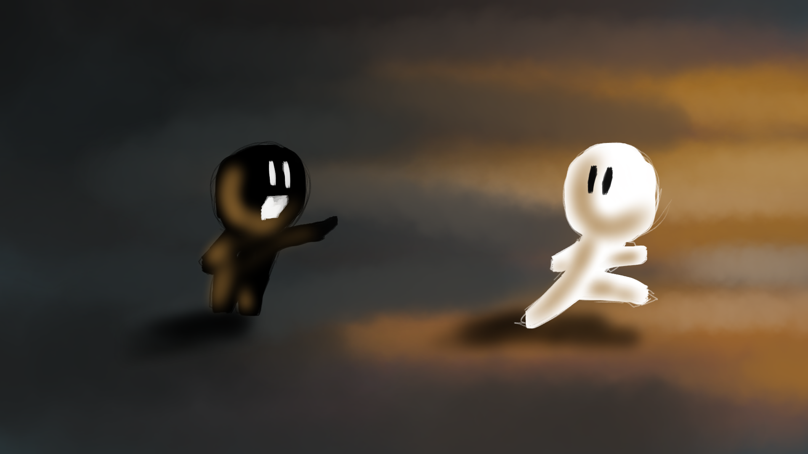
As soon as it started it had finished. Didn’t take long for my memory of Jesus to fade, or the money I had for that matter. From then on I stole a lot, kept stealing till it caught up with me and I was executed just like Jesus.
Click here to continue.
Start again

Slide 24
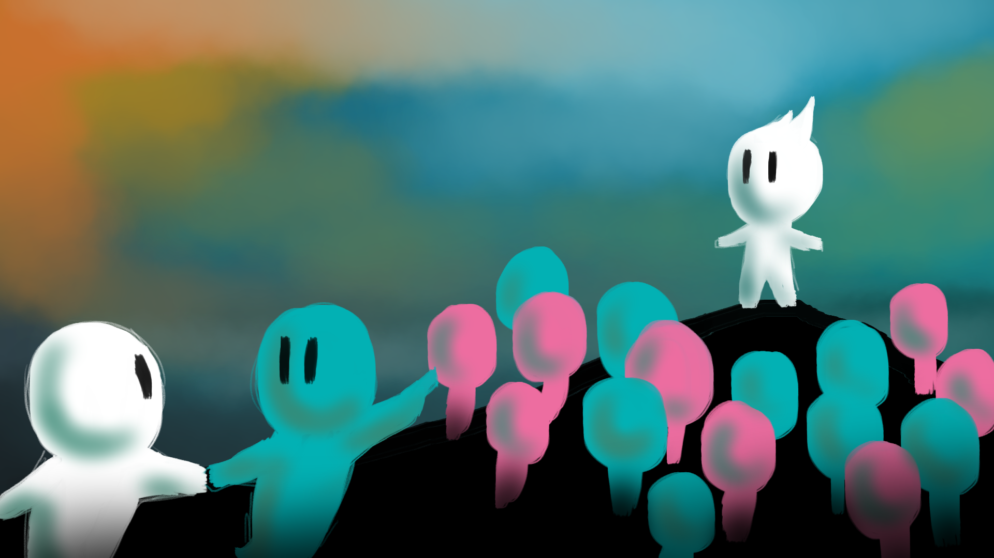
He was pretty insistent so I thought I’d go along. His name’s Jesus and he said some pretty backward things. He said if someone slaps you to offer them the other cheek. Basically to let it go and forgive them, bear no ill will towards them. Click to continue.
Start again

Slide 25
That’s mad, God can’t be a man, I knew this was a load of rubbish.
I don’t understand how it works but maybe he is God. I want to find out more.
Hard stuff to get my head around but he backed it up with his actions, he healed people, spent time with those that no one wanted to be around. Even forgave sins. I thought only God could do that. But then again he says he IS God.
Start again

Slide 26
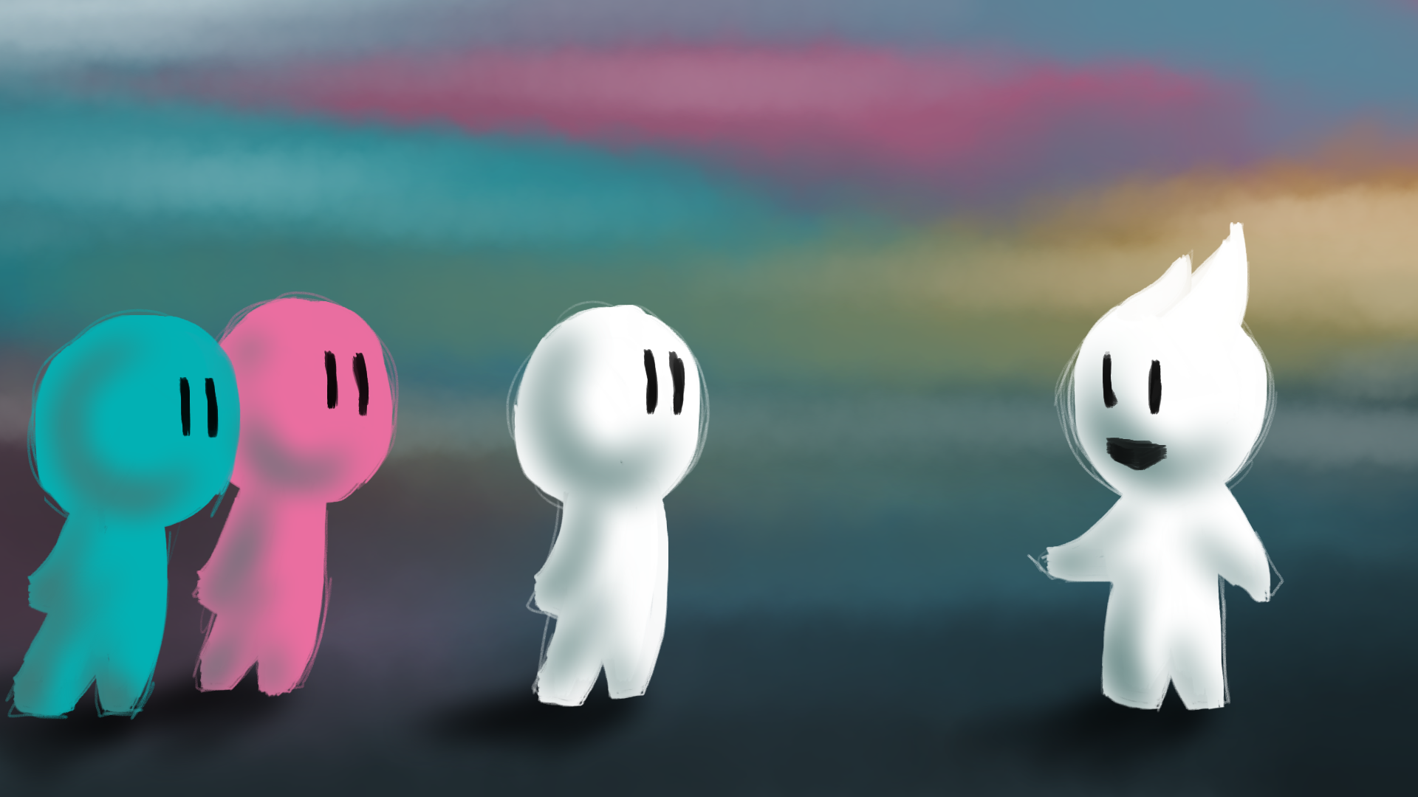
I’m a pretty good guy. I don’t want to give up my life for someone else.
If Jesus really is God, I can trust him with my life. I want to be part of what he’s doing.
I liked a lot of what Jesus said but a lot of it required some sort of response from me. One day he turned to us and said “Anyone who wants to follow me must deny themselves. Whoever loses their life for me will find it.”
Start again

Slide 27
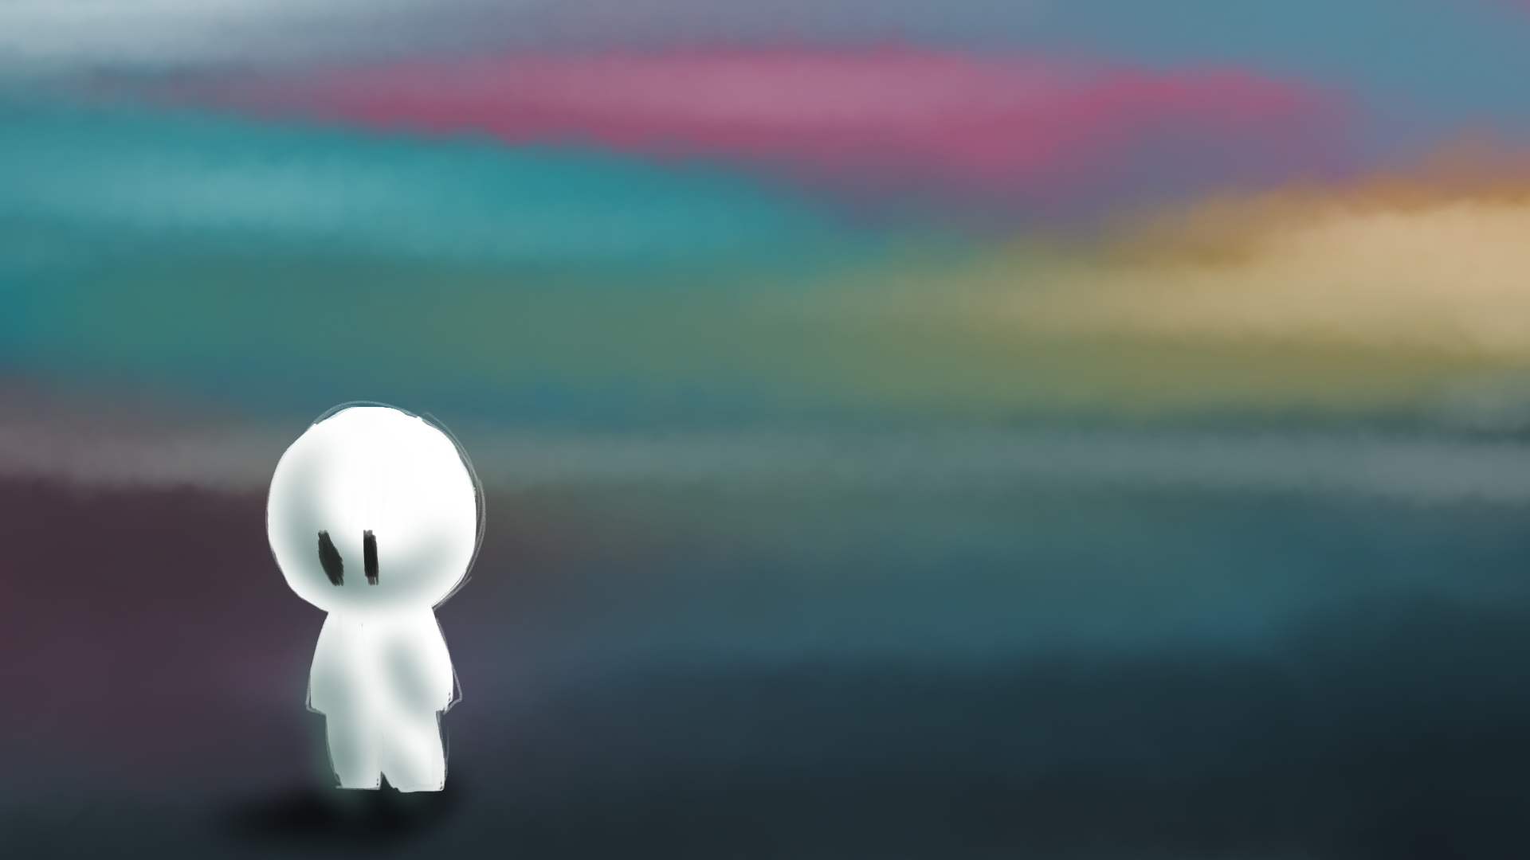
I decided that life wasn’t for me. His last talk made me wonder if he really was God. Would God really ask me to give up my life? I had enough on my plate anyway. I was still broke. I guess I’m not as good at sorting out my life as I thought I was. Click to continue.
Start again

Slide 28
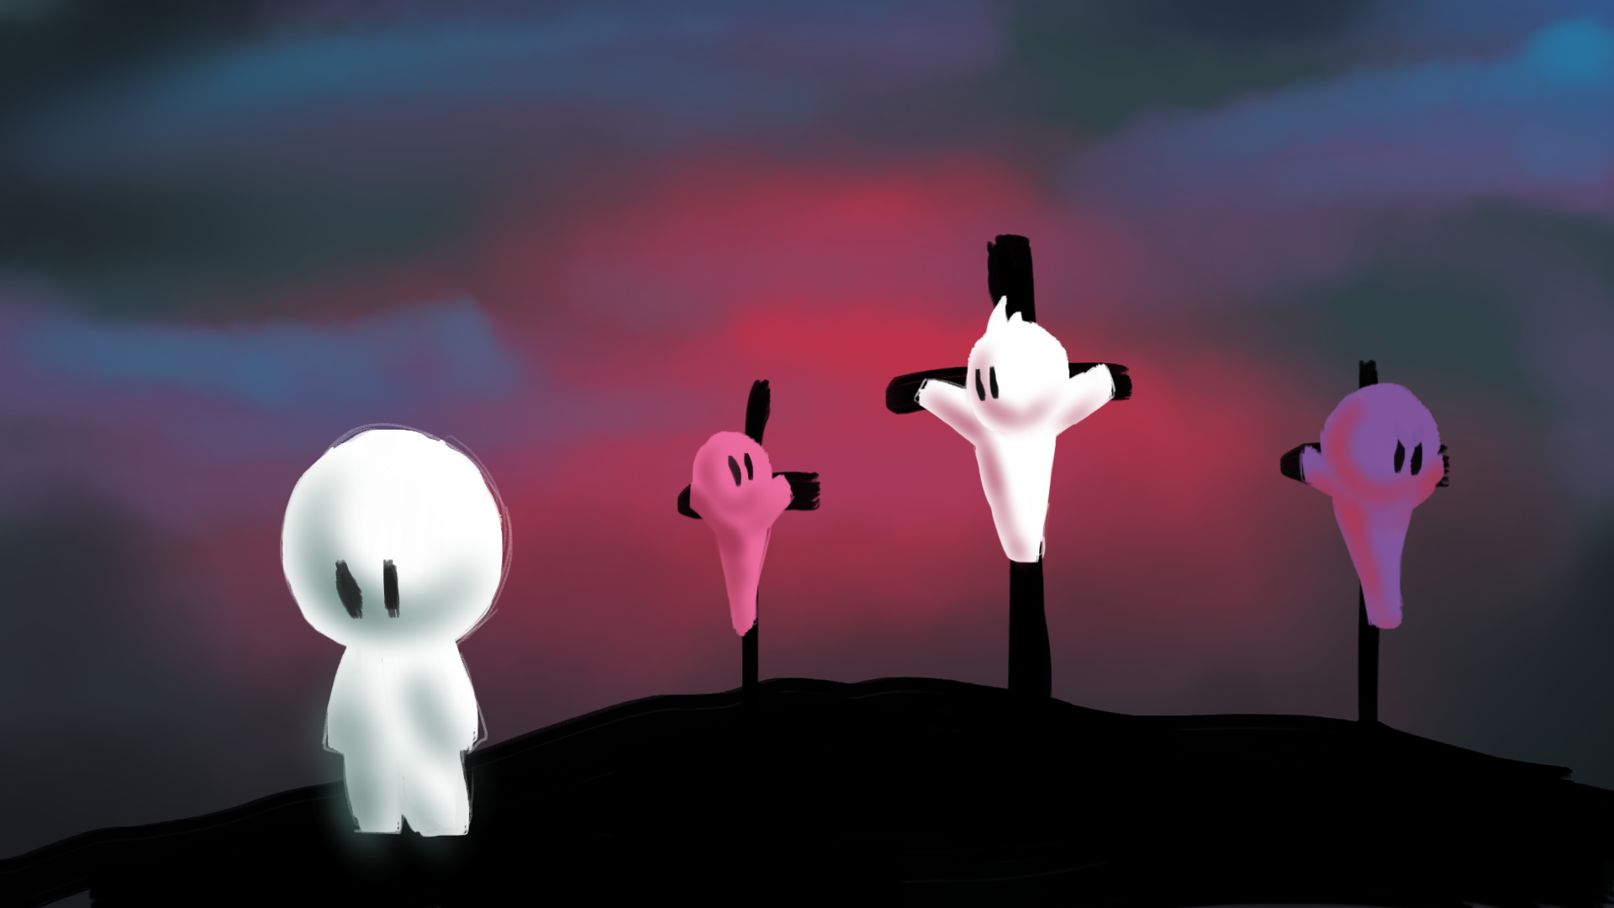
I heard Jesus was arrested and going to be crucified. No idea what he’d done wrong but I felt I should go. The crowds were horrible, they had no idea why he was up there either but they were more than happy to join in on the hatred.
Click here to continue.
Start again

Slide 29
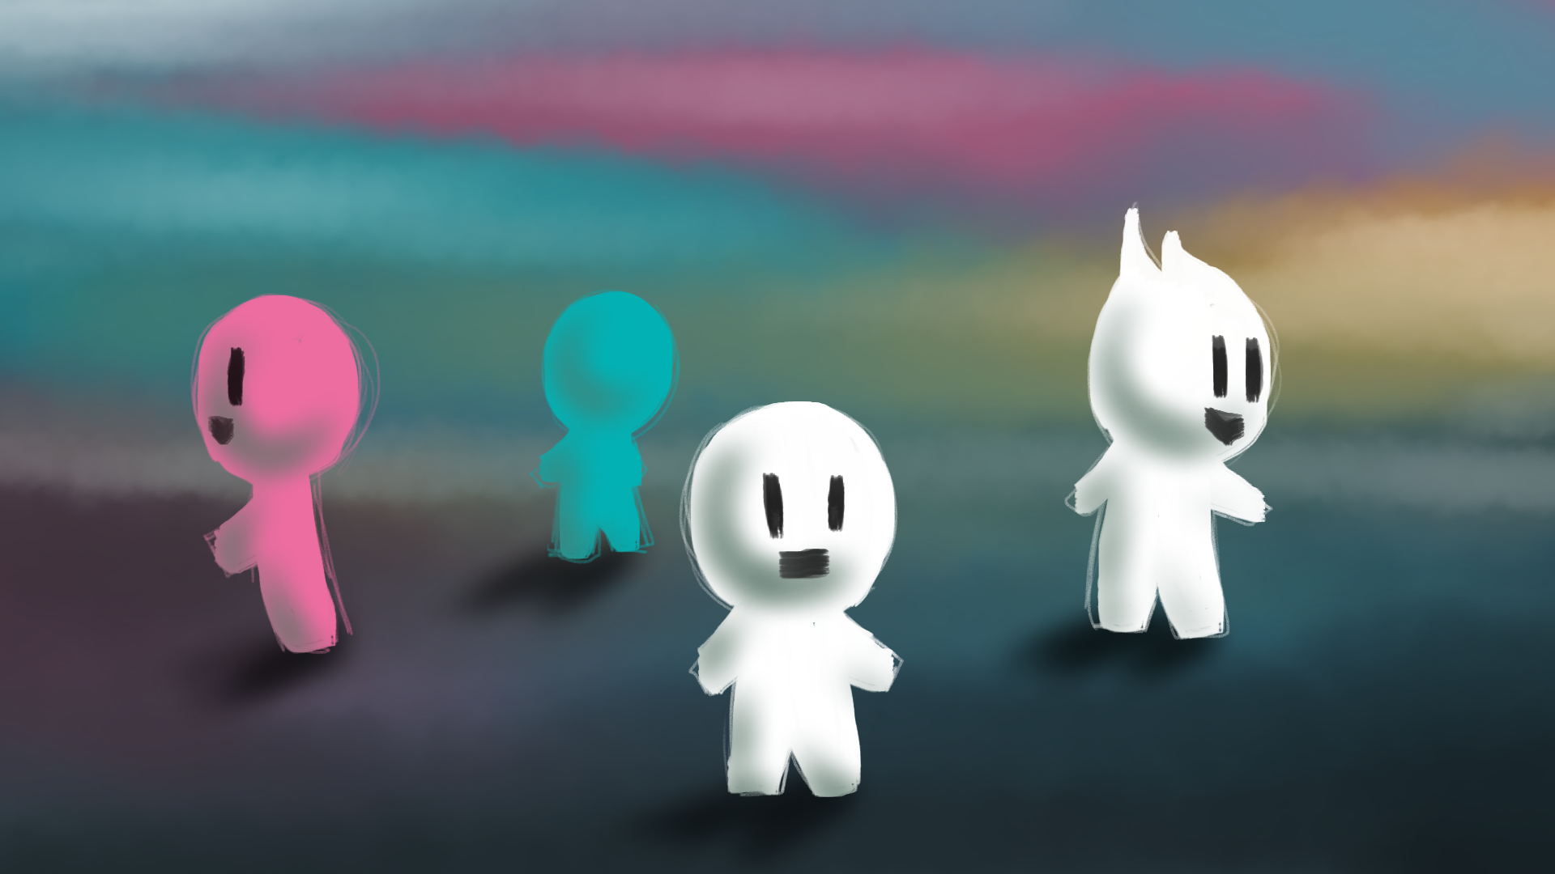
We had a fantastic time. My troubles paled in comparison to the fun I was having and the good I was doing. It was going great until one day, Jesus was arrested out of the blue. It was a scary time and we had no idea what was going on.
It was too scary. I guess when it comes right down to it, I don’t want any of this.
I have to go with him and help where I can.
Start again

Slide 30
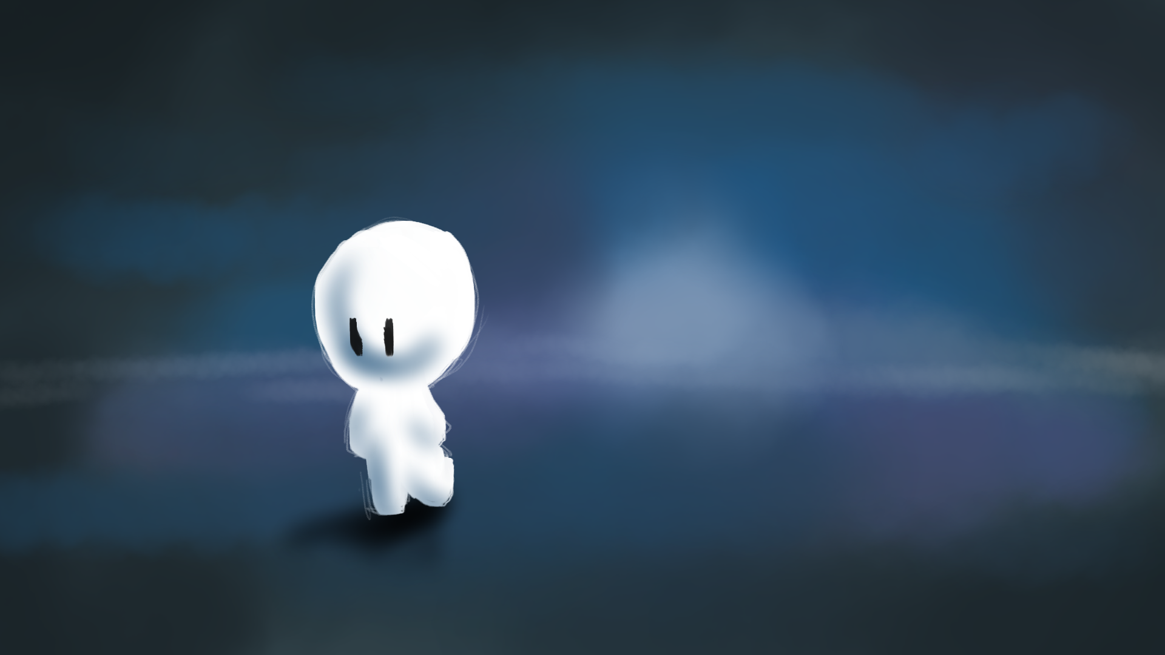
I heard what happened, they killed him. I didn’t want to stick around, knew they’d be coming for me sooner or later. It didn’t take me long to realise that I was never 100% in, I was just along for the ride otherwise I would’ve stuck it out to the end. Click to continue.
Start again

Slide 31
I distanced myself as much as I could, don’t even know what happened next. All of a sudden I was right back where I started, money struggles and all. I tried my best, did what I could until the day I died.
Click here to continue.
Start again

Slide 32
I ran, I couldn’t let them take him away…but there was nothing I could do. The trial was a farce, he was nailed to that piece of wood because the higher-ups were afraid of him. No other reason. Click to continue.
Start again

Slide 33
I want to speak out, everything inside me wants to scream that this is wrong. But I’m afraid too. Everyone around me is mocking him, they’re out for his blood and I knew they’d be out for mine if I said anything. I’m sorry Jesus, I can’t. Click to continue.
Start again

Slide 34
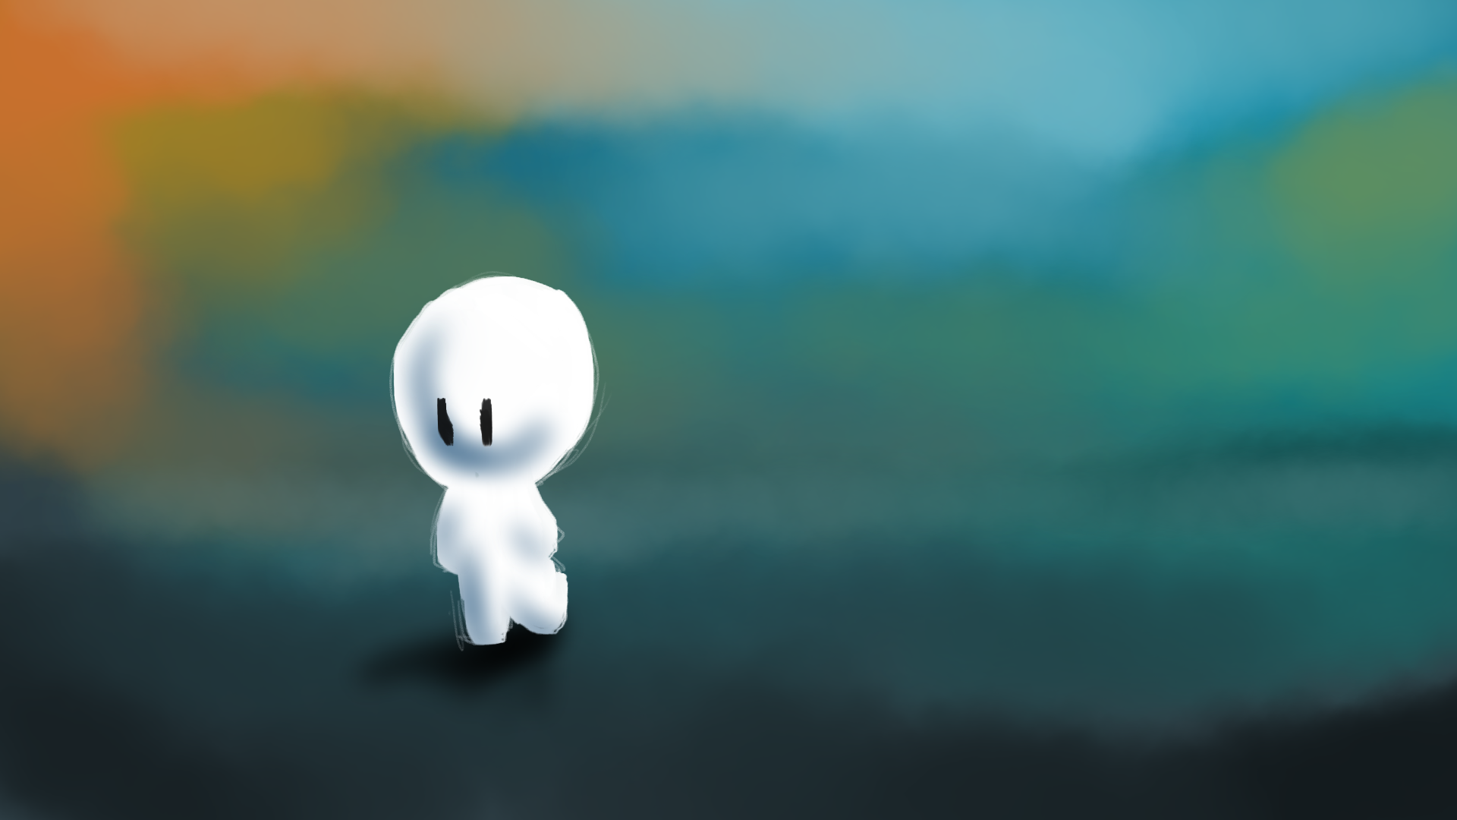
I couldn’t believe what I’d done, In Jesus greatest hour of need I failed him. I can never forgive myself…forgiveness…Jesus spoke a lot about that. Even the day he died he said “Father forgive them, they don’t know what they are doing.” Click to continue.
Start again

Slide 35
Maybe that’s it! That’s definitely it! God forgives those that are truly sorry. And it’s not just for now, it’s not just for that one thing I did wrong, it’s for everything I have done or will do wrong. God has forgiven me! I need to find the others. Click to continue.
Start again

Slide 36
Click here to continue.
I ran to find those who first told me about him. They’d figured it out too. This is what Jesus came to do, it’s what he died for. We have to tell people. And that’s what we did, for the rest of our lives we told whoever we could what Jesus did for us, for all of us.
Start again

Slide 37
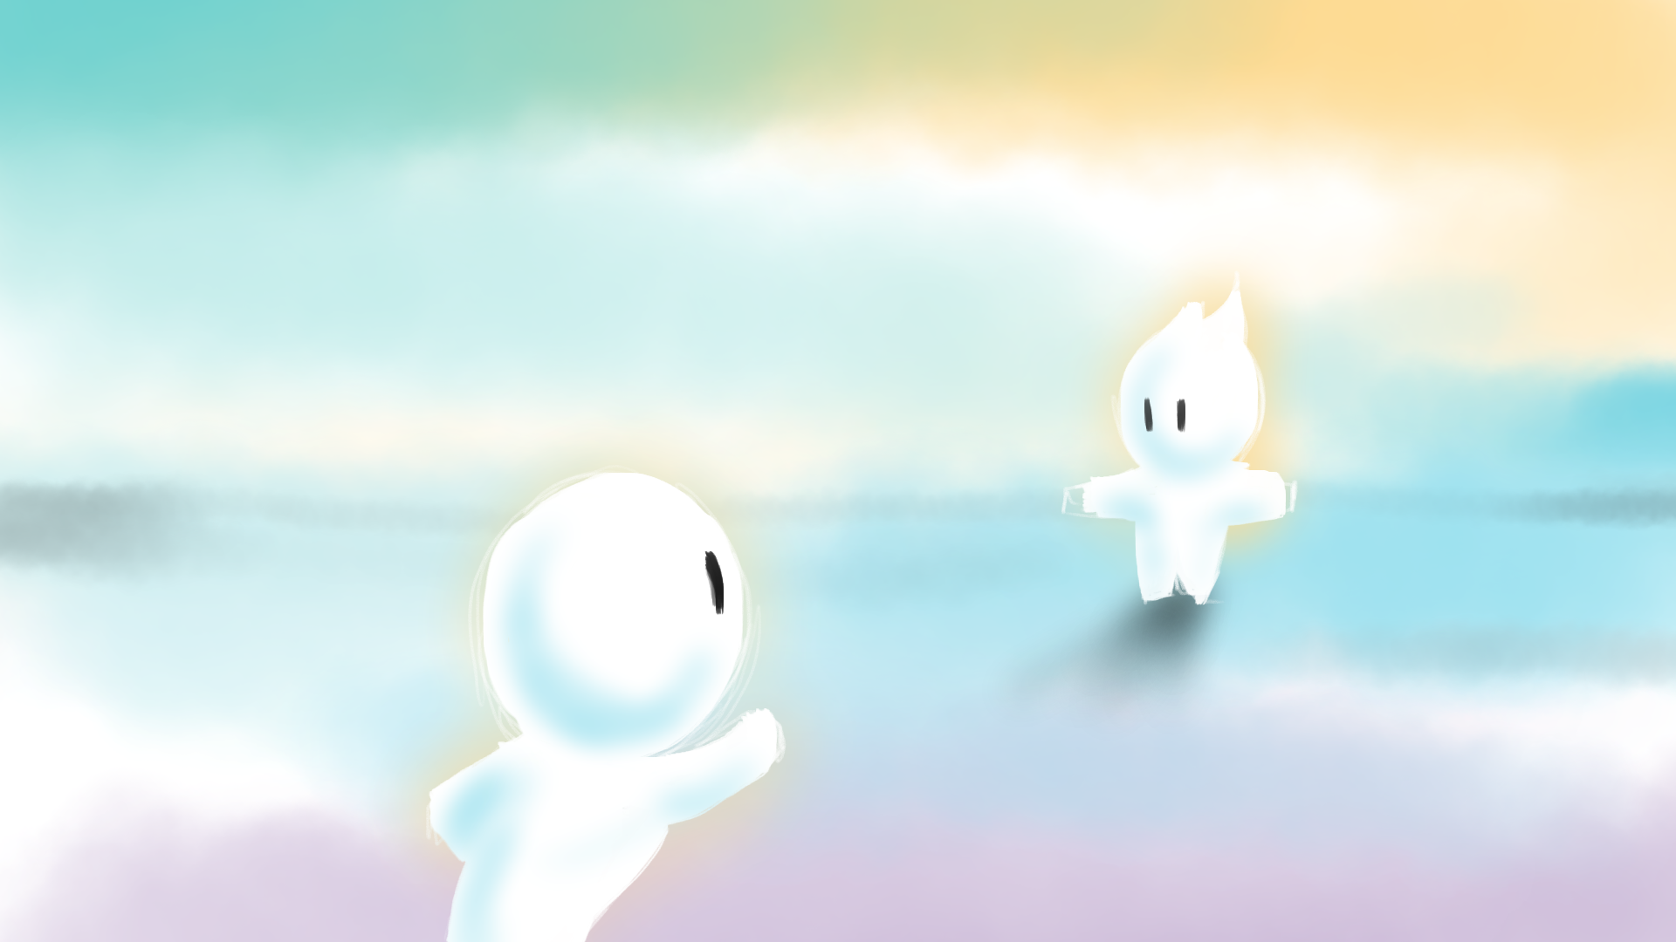
On the other side of death, he was there to meet me. With open arms he couldn’t wait to welcome me home. He spoke…“I love you, you knew me on earth and you will know me now. Today, you are with me in paradise.” And that was the beginning of forever.
Click here to continue.
Start again

Slide 38
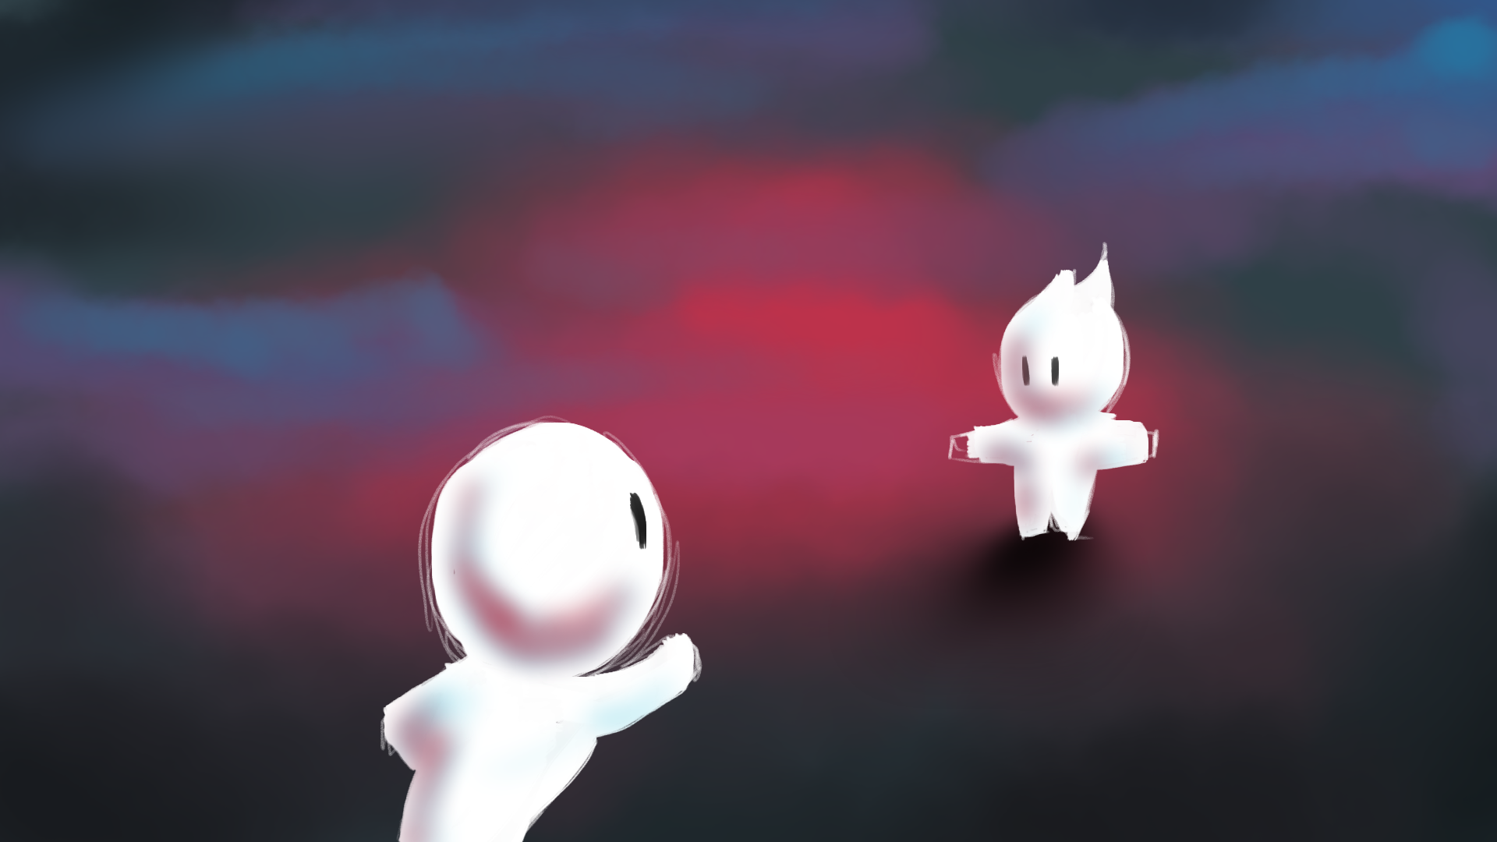
I didn’t think there was anything after death but…when I got there I found Jesus and my heart broke. He spoke…“I love you, but you had every chance to know me on earth, you chose not too. So today, you will not be with me in paradise.” Click to continue.
Start again

Slide 39
I begged, I pleaded, I knew I had made a mistake. Jesus really is God. But it’s too late now, he was right, I had every opportunity. Now I will never know him, as soon as that realisation came over me all that was good faded. There was no love or joy, only pain.
Click here to continue.
Start again

Slide 40

Thank you for playing. Please feel free to replay by clicking ‘start again’ at the bottom and make different decisions to see how the outcome changes.
Please take the time to think about this story, what decisions would you have made?
Although Jesus is not visible to us in the same way he was in the story, the decisions remain the same for us. Do we accept that Jesus is God and he took the death that we deserve and so give our lives to him as a response? Or do we reject him and try to live our best life by ourselves only to find that there is still something missing?
This story was brought to you by
Start again

